Slide 1
EMS702UP Statistical Thinking and Applied Machine Learning
W1.3 Probability Distributions
Jun Chen

Slide 2
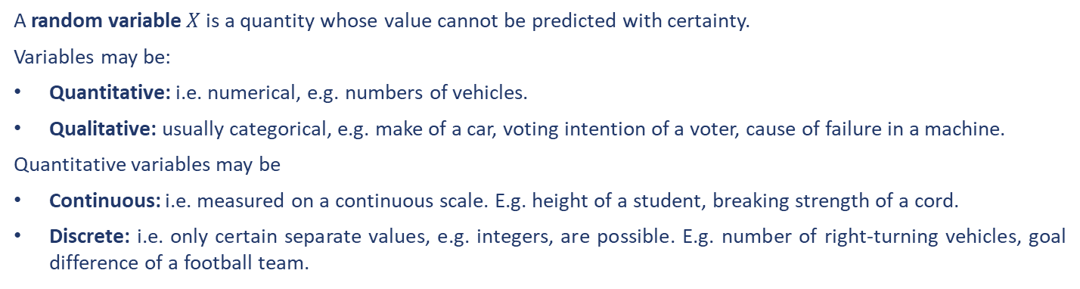
Probability Distributions
A random variable $X$ is a quantity whose value cannot be predicted with certainty.
Variables may be:
Quantitative: i.e. numerical, e.g. numbers of vehicles.
Qualitative: usually categorical, e.g. make of a car, voting intention of a voter, cause of failure in a machine.
Quantitative variables may be
Continuous: i.e. measured on a continuous scale. E.g. height of a student, breaking strength of a cord.
Discrete: i.e. only certain separate values, e.g. integers, are possible. E.g. number of right-turning vehicles, goal difference of a football team.
Distributions are often described in terms of their mass or density functions. Mass or Density functions are functions that describe how the proportion of data or likelihood of the proportion of observations change over an ordered list (discrete) or the range (continuous) of the distribution.

Slide 3
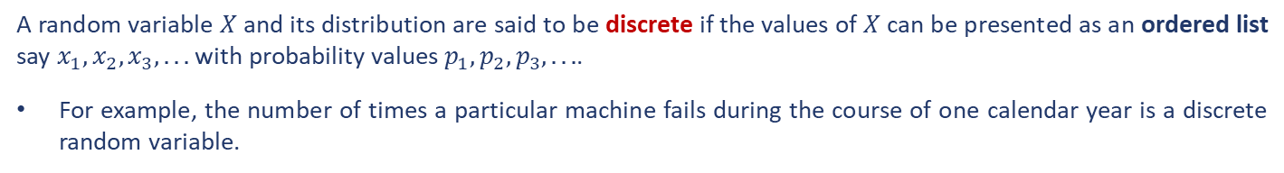
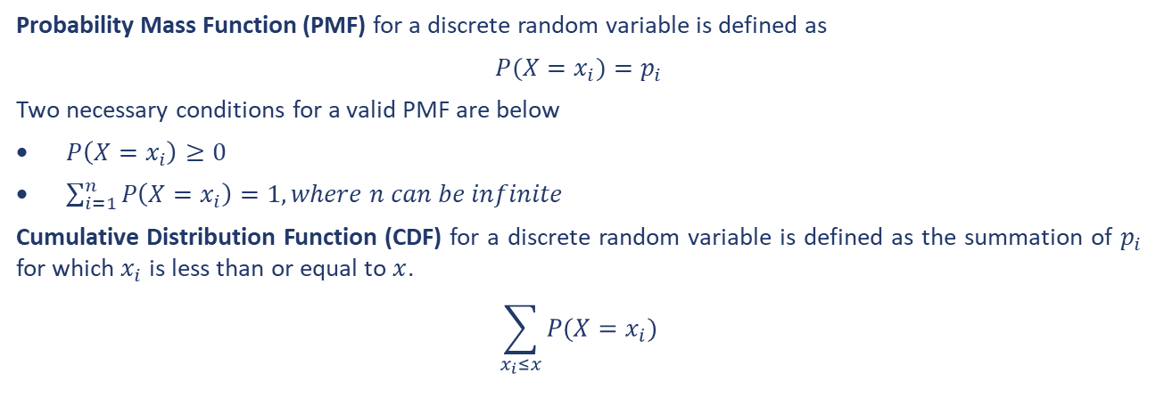
Discrete Probability Distributions
A random variable $X$ and its distribution are said to be discrete if the values of $X$can be presented as an ordered list say $x_{1}, x_{2}, x_{3}, . . .$ with probability values $p_{1}, p_{2},p_{3}, . ..$.
For example, the number of times a particular machine fails during the course of one calendar year is a discrete random variable.
Probability Mass Function (PMF) for a discrete random variable is defined as
$P(X=x_{i})=p_{i}$
Two necessary conditions for a valid PMF are below
$P\left(X=x_{i}\right)≥0$
$\sum_{i=1}^{n}{P\left(X=x_{i}\right)}=1, where n can be infinite$
Cumulative Distribution Function (CDF) for a discrete random variable is defined as the summation of $p_{i}$ for which $x_{i}$ is less than or equal to $x$.
$$\sum_{x_{i}≤x}{P(X=x_{i})}$$

Slide 4
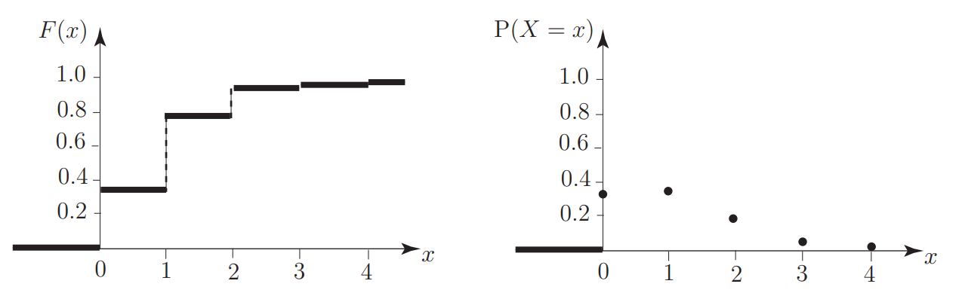
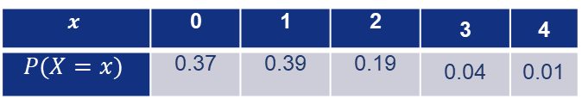
Discrete Probability Distributions
Example 14
A traffic engineer is interested in the number of vehicles reaching a particular crossroads during periods of relatively low traffic flow. The engineer finds that the number of vehicles X reaching the crossroads per minute is governed by the probability distribution:
Graph the PMF and the corresponding CDF.
Solution
$$x$$ | 0 | 1 | 2 | 3 | 4
$$P(X=x)$$ | 0.37 | 0.39 | 0.19 | 0.04 | 0.01

Slide 5
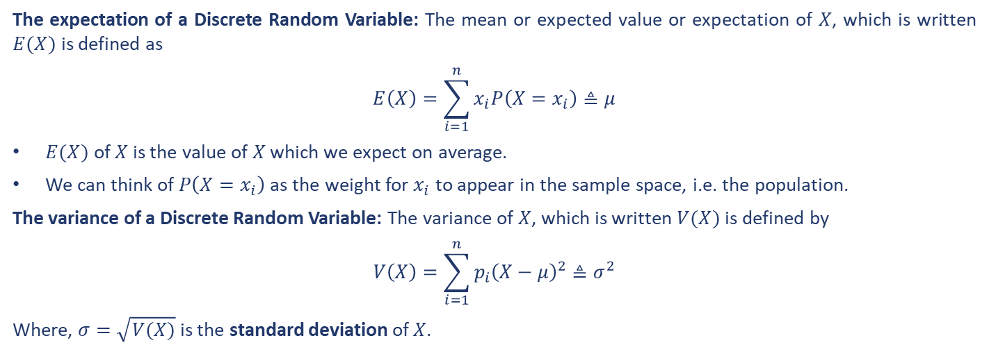
Discrete Probability Distributions
The expectation of a Discrete Random Variable: The mean or expected value or expectation of $X$, which is written $E(X)$ is defined as
$$E\left(X\right)=\sum_{i=1}^{n}{x_{i}P\left(X=x_{i}\right)}≜μ$$
$E(X)$ of $X$ is the value of $X$ which we expect on average.
We can think of $P\left(X=x_{i}\right)$ as the weight for $x_{i}$ to appear in the sample space, i.e. the population.
The variance of a Discrete Random Variable: The variance of $X$, which is written $V(X)$ is defined by
$$V\left(X\right)=\sum_{i=1}^{n}{p_{i}{\left(X−μ\right)}^{2}}≜σ^{2}$$
Where, $σ=\sqrt{V(X)}$ is the standard deviation of $X$.

Slide 6
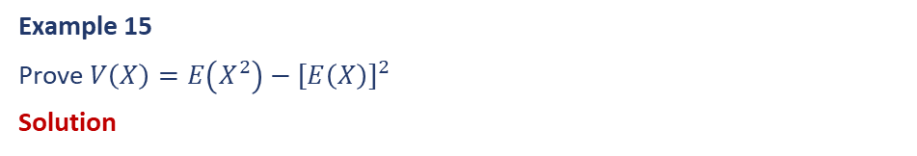
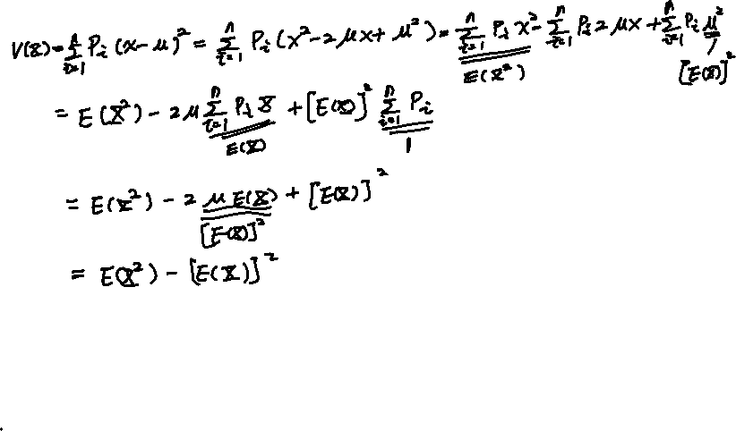
Discrete Probability Distributions
Example 15
Prove $V\left(X\right)=E\left(X^{2}\right)−[E\left(X\right)]^{2}$
Solution

Slide 7
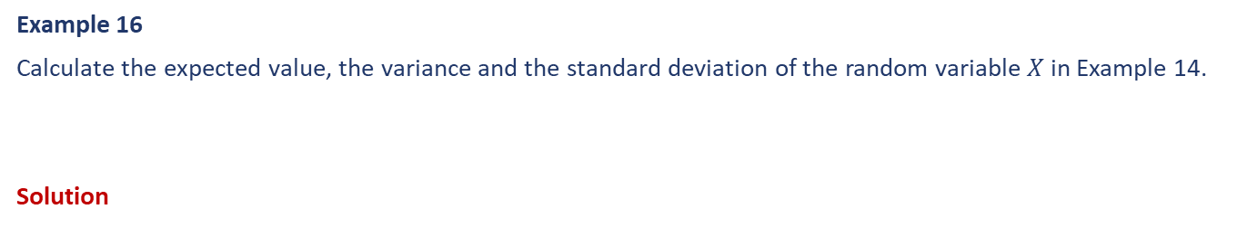
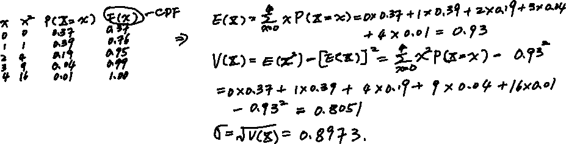
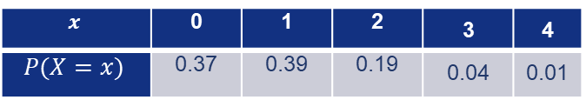
Discrete Probability Distributions
Example 16
Calculate the expected value, the variance and the standard deviation of the random variable $X$ in Example 14.
Solution
$$x$$ | 0 | 1 | 2 | 3 | 4
$$P(X=x)$$ | 0.37 | 0.39 | 0.19 | 0.04 | 0.01

Slide 8
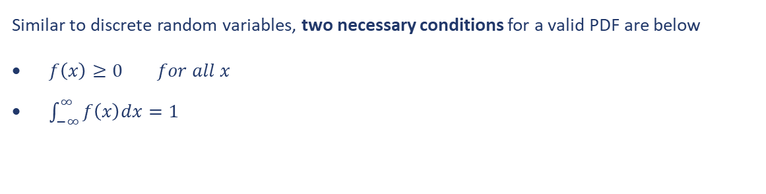
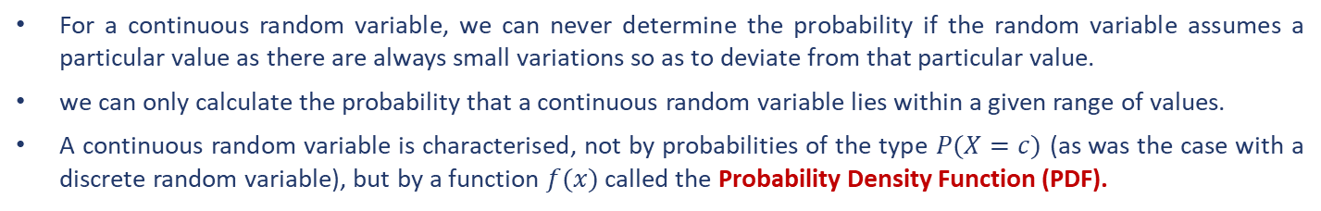
Continuous Probability Distributions
A random variable $X$ is said to be continuous if it can assume any value in a given interval.
For a continuous random variable, we can never determine the probability if the random variable assumes a particular value as there are always small variations so as to deviate from that particular value.
we can only calculate the probability that a continuous random variable lies within a given range of values.
A continuous random variable is characterised, not by probabilities of the type $P(X=c)$ (as was the case with a discrete random variable), but by a function $f(x)$ called the Probability Density Function (PDF).
Similar to discrete random variables, two necessary conditions for a valid PDF are below
$f\left(x\right)≥0 for all x$
$\int_{−∞}^{∞}{f\left(x\right)dx}=1$

Slide 9
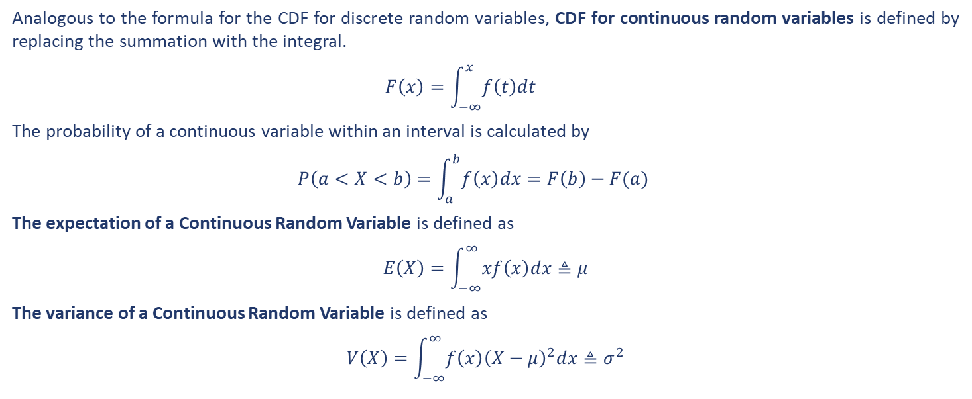
Continuous Probability Distributions
Analogous to the formula for the CDF for discrete random variables, CDF for continuous random variables is defined by replacing the summation with the integral.
$$F\left(x\right)=\int_{−∞}^{x}{f\left(t\right)dt}$$
The probability of a continuous variable within an interval is calculated by
$$P\left(a<X<b\right)=\int_{a}^{b}{f\left(x\right)dx}=F\left(b\right)−F(a)$$
The expectation of a Continuous Random Variable is defined as
$$E\left(X\right)=\int_{−∞}^{∞}{xf\left(x\right)dx}≜μ$$
The variance of a Continuous Random Variable is defined as
$$V\left(X\right)=\int_{−∞}^{∞}{f\left(x\right){\left(X−μ\right)}^{2}dx}≜σ^{2}$$

Slide 10
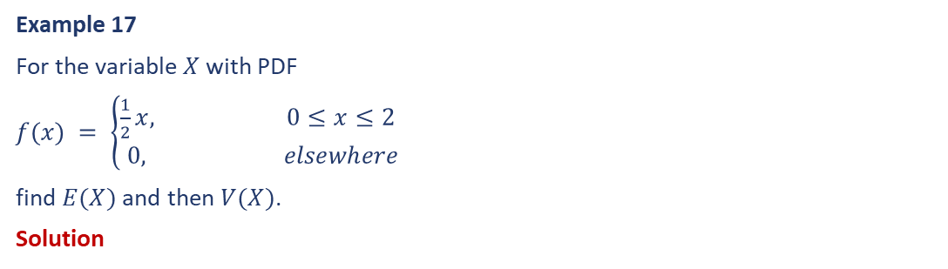
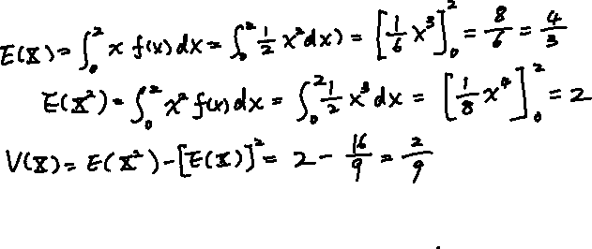
Continuous Probability Distributions
Example 17
For the variable $X$ with PDF
$f(x) = \left\{\begin{aligned}\frac{1}{2}x, 0≤x≤2 \\ 0, elsewhere \end{aligned}\right.$
find $E(X)$ and then $V(X)$.
Solution

Slide 11
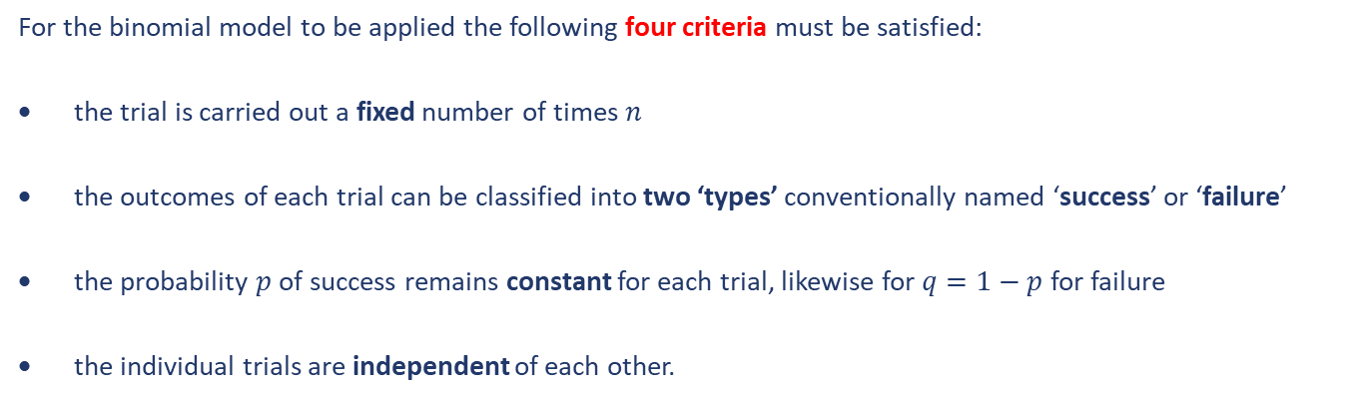
Discrete Probability Distribution – Binomial Distribution
The binomial distribution allows us to calculate the probability of observing a certain number of successes in a given number of trials. The Binomial Distribution is one of the commonly used discrete distributions.
For the binomial model to be applied the following four criteria must be satisfied:
the trial is carried out a fixed number of times $n$
the outcomes of each trial can be classified into two ‘types’ conventionally named ‘success’ or ‘failure’
the probability $p$ of success remains constant for each trial, likewise for $q=1−p$ for failure
the individual trials are independent of each other.

Slide 12
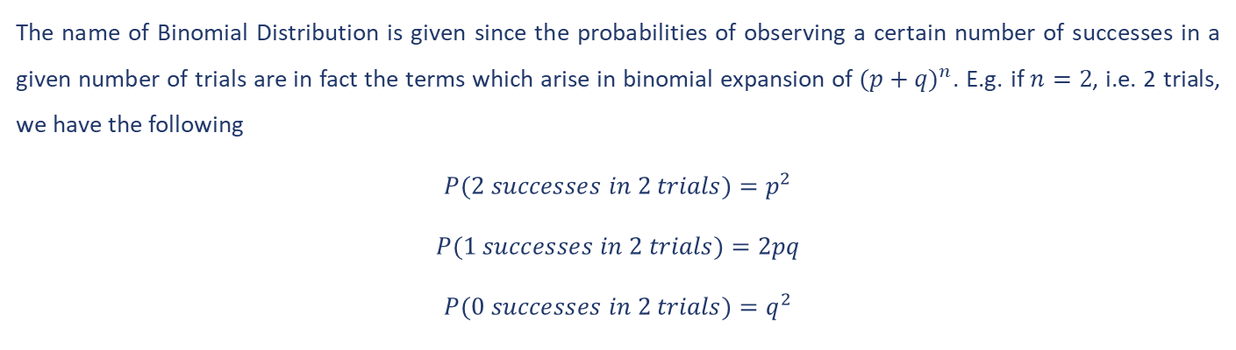

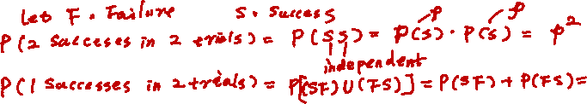
Discrete Probability Distribution – Binomial Distribution
The name of Binomial Distribution is given since the probabilities of observing a certain number of successes in a given number of trials are in fact the terms which arise in binomial expansion of $(p+q)^{n}$. E.g. if $n=2$, i.e. 2 trials, we have the following
$$P(2 successes in 2 trials)=p^{2}$$
$$P(1 successes in 2 trials)=2pq$$
$$P(0 successes in 2 trials)=q^{2}$$

Slide 13

Discrete Probability Distribution – Binomial Distribution
Let $X$ be a discrete random variable, being the number of successes occurring in $n$ independent trials of an experiment. If $X$ is to be described by the binomial model, the probability of exactly $r$ successes in $n$ trials is given by
$$P(X=r)={}_{}^{n}{C_{r}}p^{r}q^{n−r}$$
Here there are $r$ successes (each with probability $p$), $n−r$ failures (each with probability $q$) and
$${}_{}^{n}{C_{r}}=\frac{n!}{r!(n−r)!}$$
is the number of ways of taking $r$ objects among the $n$ trials.
If a random variable $X$ follows a binomial distribution in which an experiment is repeated $n$ times each with probability $p$ of success then we write $X∼B(n, p)$.

Slide 14

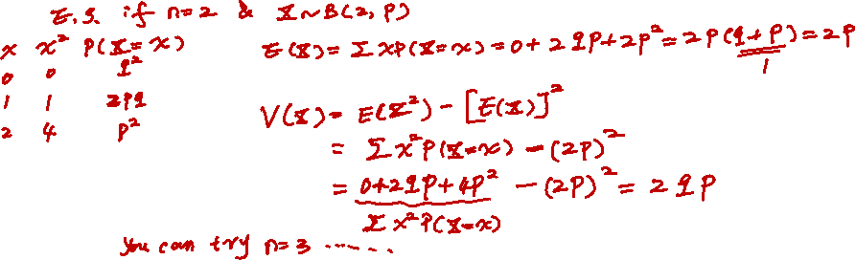
Discrete Probability Distribution – Binomial Distribution
Without proof, the expectation and variance of the Binomial distribution are given by the formulae
$$E\left(X\right)= np$$
$$V (X) = np(1 − p) = npq$$

Slide 15
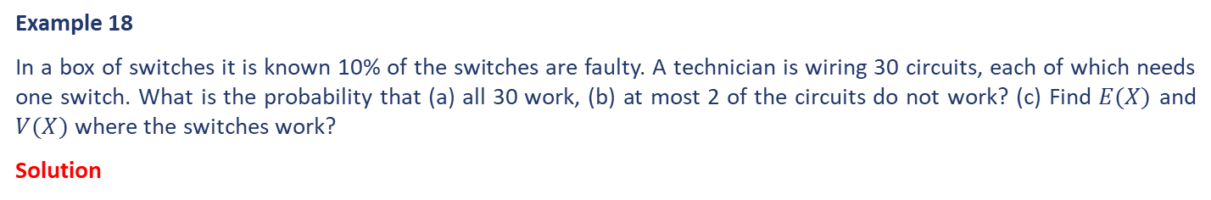
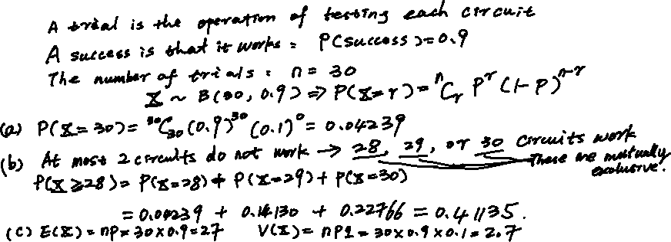
Discrete Probability Distribution – Binomial Distribution
Example 18
In a box of switches it is known 10% of the switches are faulty. A technician is wiring 30 circuits, each of which needs one switch. What is the probability that (a) all 30 work, (b) at most 2 of the circuits do not work? (c) Find $E(X)$ and $V(X)$ where the switches work?
Solution

Slide 16
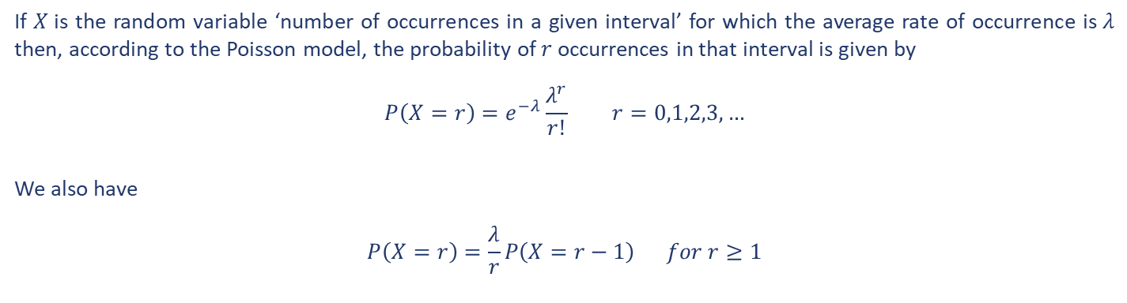
Discrete Probability Distribution – Poisson Distribution
The Poisson distribution is a probability model which can be used to find the probability of a single event occurring a given number of times in an interval of (usually) time.
Only the occurrence of an event can be counted
The non-occurrence of an event cannot be counted
If $X$is the random variable ‘number of occurrences in a given interval’ for which the average rate of occurrence is $λ$ then, according to the Poisson model, the probability of $r$ occurrences in that interval is given by
$$P\left(X=r\right)=e^{−λ}\frac{λ^{r}}{r!} r=0,1,2,3,…$$
We also have
$$P\left(X=r\right)=\frac{λ}{r}P\left(X=r−1\right) for r≥1$$

Slide 17
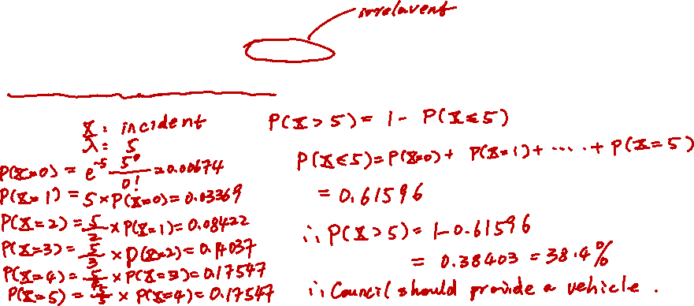
Discrete Probability Distribution – Poisson Distribution
Example 19
A Council is considering whether to base a recovery vehicle on a stretch of road to help clear incidents as quickly as possible. The road concerned carries over 5000 vehicles during the peak rush hour period. Records show that, on average, the number of incidents during the morning rush hour is 5. The Council won’t base a vehicle on the road if the probability of having more than 5 incidents in any one morning is less than 30%. Based on this information should the Council provide a vehicle?
Solution

Slide 18

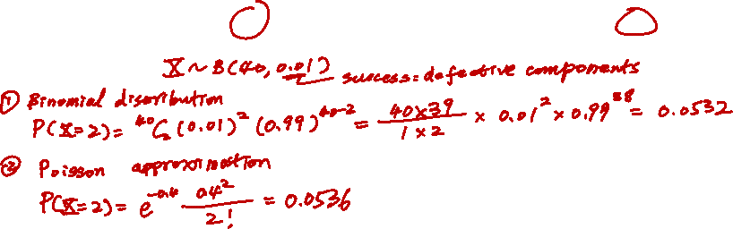
Discrete Probability Distribution – Poisson Distribution
One application of the Poisson distribution is to approximate the probability of the outcome $X=r$ of the Binomial distribution subject to the following conditions.
$n$ is large $p$ is small $np =λ$
Example 20
A worn machine which is known to produce 1% defective components is used for a production run of 40 components. Use both the Binomial distribution and its Poisson approximation to calculate the probability that two defective items are produced for comparison.
Solution

Slide 19
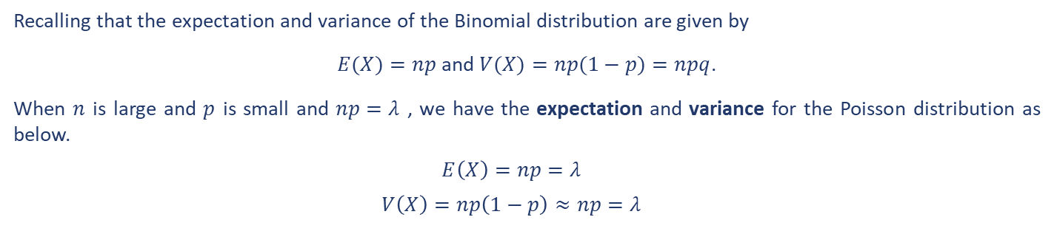

Discrete Probability Distribution – Poisson Distribution
Recalling that the expectation and variance of the Binomial distribution are given by
$E(X)=np$ and $V(X)=np(1−p)=npq$.
When $n$ is large and $p$ is small and $np=λ$ , we have the expectation and variance for the Poisson distribution as below.
$$E\left(X\right)=np=λ$$
$$V\left(X\right)=np\left(1−p\right)≈np=λ$$

Slide 20
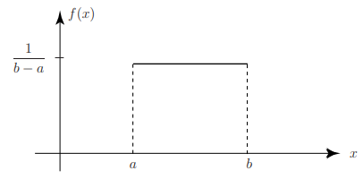
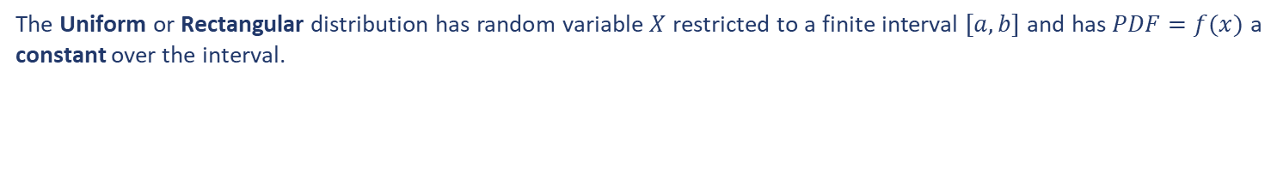
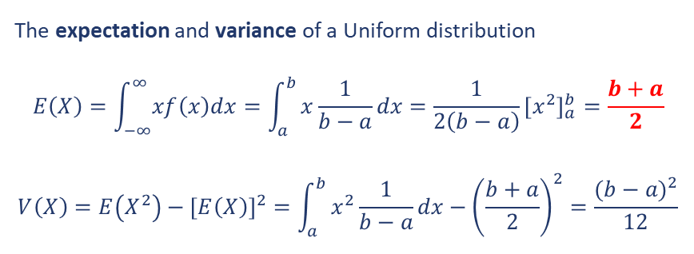
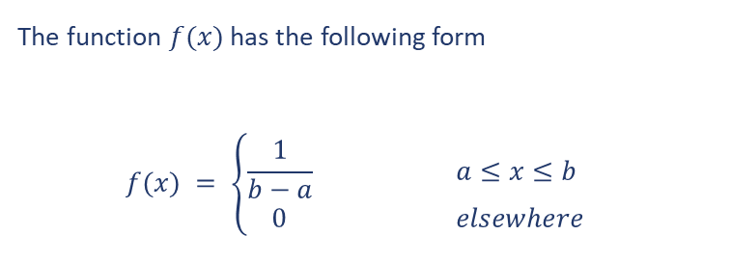
Continuous Probability Distribution – Uniform Distribution
The Uniform or Rectangular distribution has random variable $X$ restricted to a finite interval $[a, b]$ and has $PDF=f(x)$ a constant over the interval.
The expectation and variance of a Uniform distribution
$$E\left(X\right)=\int_{−∞}^{∞}{xf\left(x\right)dx}=\int_{a}^{b}{x\frac{1}{b−a}dx}=\frac{1}{2\left(b−a\right)}{\left[x^{2}\right]}_{a}^{b}=\frac{b+a}{2}$$
$$V\left(X\right)=E\left(X^{2}\right)−[E\left(X\right)]^{2}=\int_{a}^{b}{x^{2}\frac{1}{b−a}dx}−{\left(\frac{b+a}{2}\right)}^{2}=\frac{{(b−a)}^{2}}{12}$$
The function $f(x)$ has the following form
$$f(x) = \left\{\begin{aligned}\frac{1}{b−a} a≤x≤b \\ 0 elsewhere \end{aligned}\right.$$

Slide 21
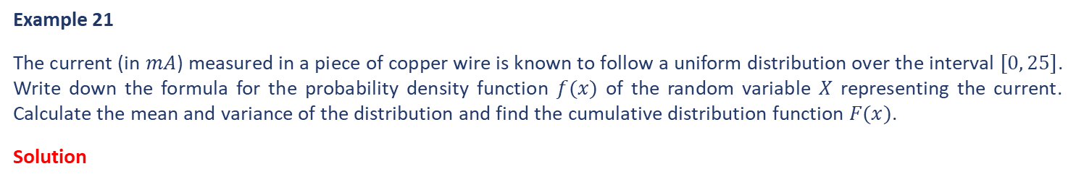
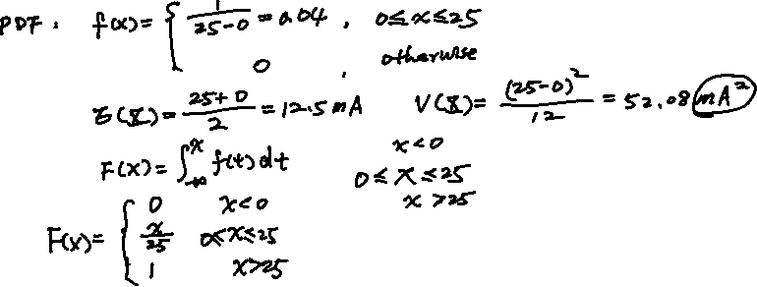
Continuous Probability Distribution – Uniform Distribution
Example 21
The current (in $mA$) measured in a piece of copper wire is known to follow a uniform distribution over the interval $[0, 25]$. Write down the formula for the probability density function $f(x)$ of the random variable $X$ representing the current. Calculate the mean and variance of the distribution and find the cumulative distribution function $F(x)$.
Solution

Slide 22
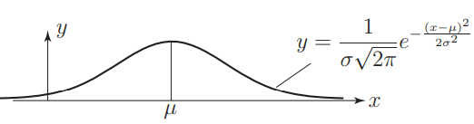
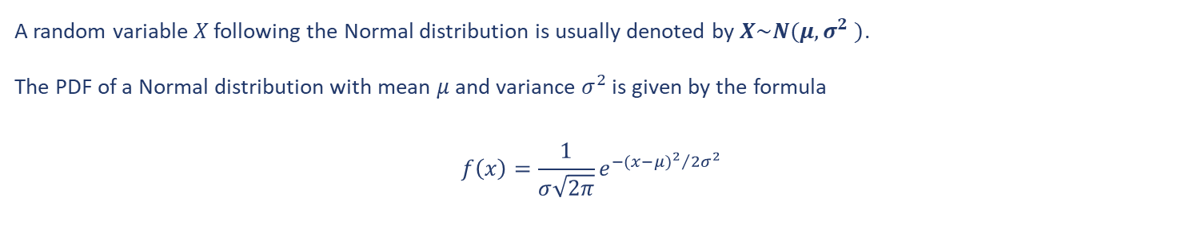
Continuous Probability Distribution – Normal Distribution
Data from many fields of study surprisingly can be described using a Gaussian distribution, so much so that the distribution is often called the Normal distribution because it is so common.
A random variable $X$ following the Normal distribution is usually denoted by $X\sim N(μ,σ^{2} )$.
The PDF of a Normal distribution with mean $μ$ and variance $σ^{2}$ is given by the formula
$$f\left(x\right)=\frac{1}{σ\sqrt{2π}}e^{{−{(x−μ)}^{2}}/{2σ^{2}}}$$
The height of the bell is controlled by the value of $σ$.

Slide 23
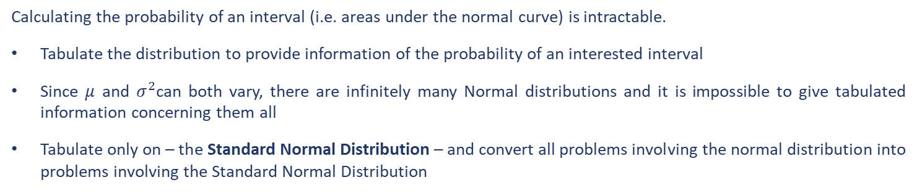
Continuous Probability Distribution – Normal Distribution
Calculating the probability of an interval (i.e. areas under the normal curve) is intractable.
Tabulate the distribution to provide information of the probability of an interested interval
Since $μ$ and $σ^{2}$can both vary, there are infinitely many Normal distributions and it is impossible to give tabulated information concerning them all
Tabulate only on – the Standard Normal Distribution – and convert all problems involving the normal distribution into problems involving the Standard Normal Distribution

Slide 24
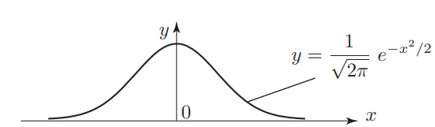
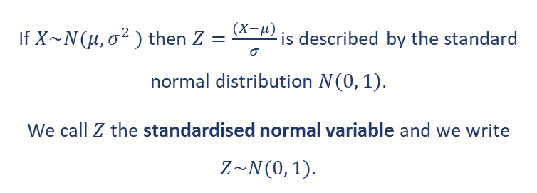
Continuous Probability Distribution – Normal Distribution
The Standard Normal Distribution has a mean of zero and a variance of one.
If $X\sim N(μ,σ^{2} )$ then $Z=\frac{(X−μ)}{σ}$ is described by the standard normal distribution $N\left(0, 1\right)$.
We call $Z$ the standardised normal variable and we write $Z\sim N(0, 1)$.

Slide 25
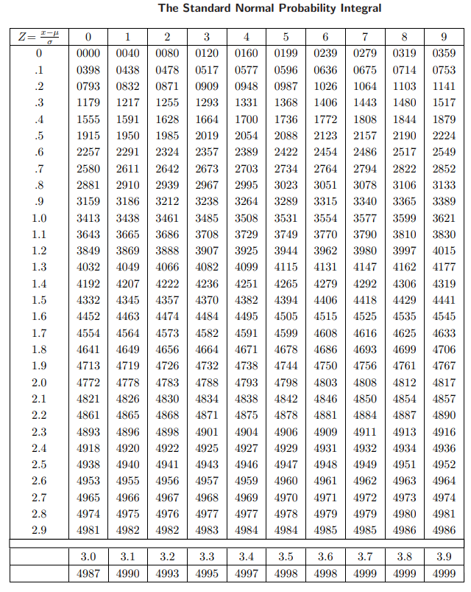
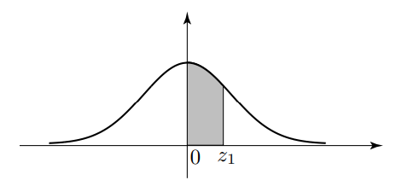
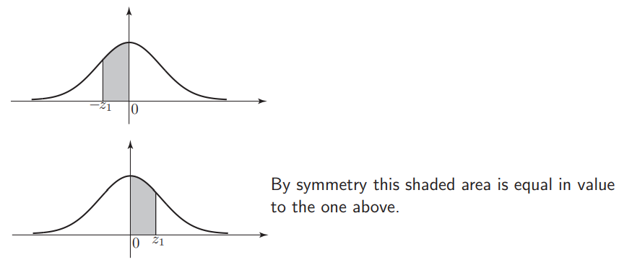

Continuous Probability Distribution – Normal Distribution
The shaded area is the probability that $Z$ takes values between 0 and $z_{1}$.
When we ‘look-up’ a value in the table we obtain the value of the shaded area.

Slide 26
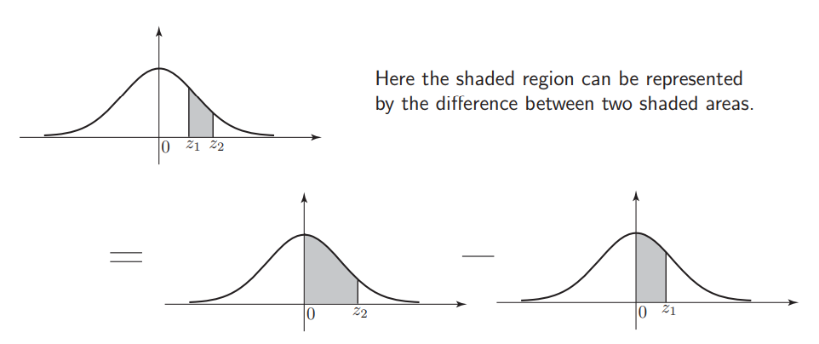
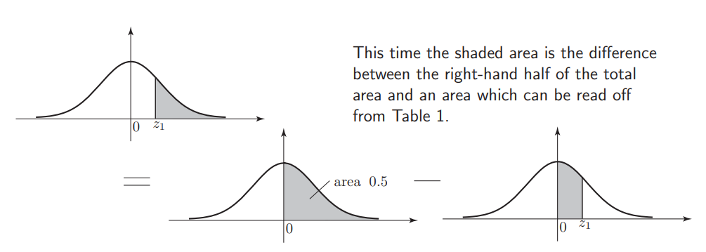
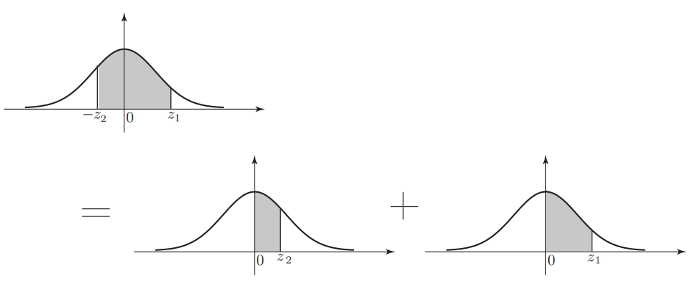
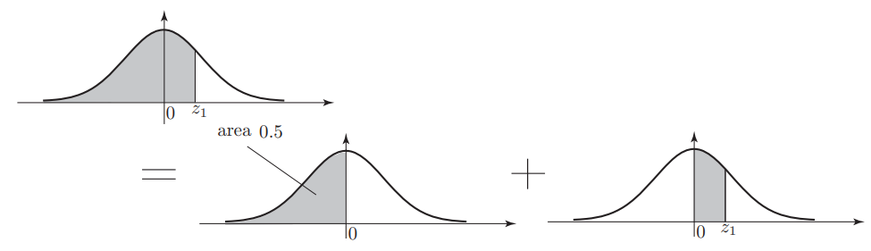
Continuous Probability Distribution – Normal Distribution
The table enables us to calculate the probabilities of any given intervals of any normal distributions.
Case 1
Case 2
Case 4
Case 3

Slide 27
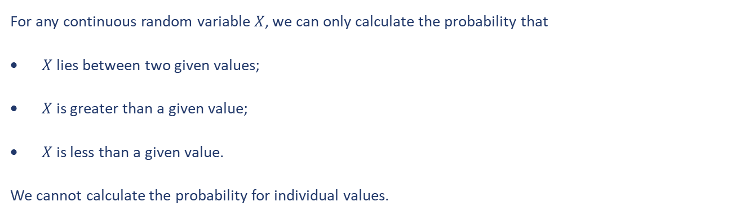
Continuous Probability Distribution – Normal Distribution
For any continuous random variable $X$, we can only calculate the probability that
$X$ lies between two given values;
$X$ is greater than a given value;
$X$ is less than a given value.
We cannot calculate the probability for individual values.

Slide 28
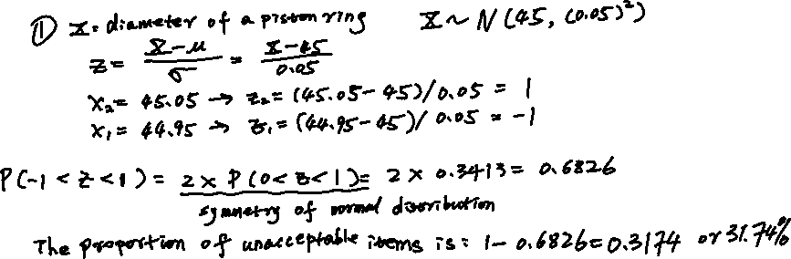
Continuous Probability Distribution – Normal Distribution
Example 22
Piston rings are mass-produced. The target internal diameter is 45 mm but records show that the diameters are normally distributed with mean 45 mm and standard deviation 0.05 mm. An acceptable diameter is one within the range 44.95 mm to 45.05 mm. What proportion of the output is unacceptable? If the standard deviation is halved by improved production practices what is now the proportion of unacceptable items?
Solution

Slide 29
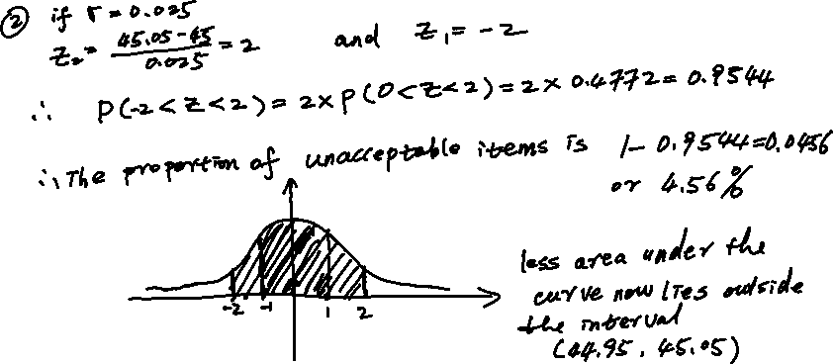
Continuous Probability Distribution – Normal Distribution
Example 22 – continued…
Solution

Slide 30
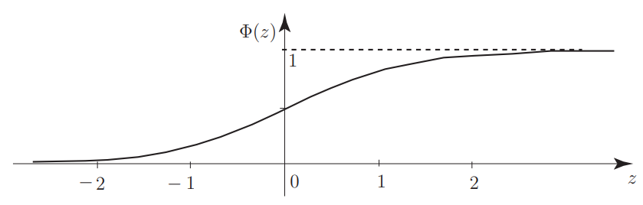


Continuous Probability Distribution – Normal Distribution
In the case of the cumulative distribution for the standard normal curve, we have the following for the CDF.
$$Φ\left(z\right)=\frac{1}{\sqrt{2π}}\int_{−∞}^{Z}{e^{−{u^{2}}/2}du}$$
$$P\left(a<X<b\right)=F\left(b\right)−F\left(a\right)=Φ\left( \frac{b−µ}{σ} \right)−Φ\left( \frac{a−µ}{σ} \right)$$
$F\left(x\right)$ is the CDF of any given Normal distribution.

Slide 31

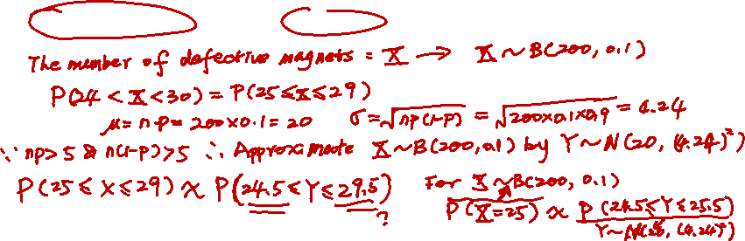
Continuous Probability Distribution – Normal Distribution
Normal distribution can be used to approximate the Binomial distribution, given the following conditions are satisfied.
$np>5$ $n(1−p)>5$
Example 23
A particular production process used to manufacture ferrite magnets used to operate reed switches in electronic meters is known to give 10% defective magnets on average. If 200 magnets are randomly selected, what is the probability that the number of defective magnets is between 24 and 30?
Solution

Slide 32
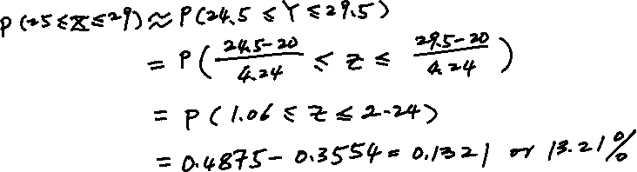
Continuous Probability Distribution – Normal Distribution
Example 23
Solution

Slide 33




Continuous Probability Distribution – Normal Distribution
In general, adding/subtracting $n$ independent Normal random variables with different means and variances result in a new Normal random variable with its being
$$E\left(X_{1}+X_{2}+…+X_{n}\right)=E\left(X_{1}\right)+E\left(X_{2}\right)+…+E\left(X_{n}\right)$$
$$V\left(X_{1}±X_{2}±…±X_{n}\right)=V\left(X_{1}\right)+V\left(X_{2}\right)+…+V\left(X_{n}\right)$$
Example 24
In a certain mass-produced assembly, a 3 $cm$ shaft must slide into a cylindrical sleeve. Shafts are manufactured whose diameter S follows a Normal distribution $S\sim N(3, 0.004^{2})$ and cylindrical sleeves are manufactured whose internal diameter $C$ follows a Normal distribution $C\sim N(3.010, 0.003^{2})$. Assembly is performed by selecting a shaft and a cylindrical sleeve at random. In what proportion of cases will it be impossible to fit the selected shaft and cylindrical sleeve together?
Solution

Slide 34
End slide

